Slide 1
CLASS-XI
SUB-MATHEMATICS
TOPIC-BINOMIAL THEOREM

Slide 2
Binomial Theorem
Learning Objectives
The students will be able to
Remember the structure of Pascal's Triangle
Remember Binomial theorem
Understood how to expand (a+b)^{n}
Apply formula for Computing binomial coefficients

Slide 3
Analyze powers of a binomial by Pascal's Triangle and by binomial coefficients.
Find approximate of numbers using binomial expansions.
Find General term of any binomial expansion
Find middle term of binomial expansion
Design the formula how to find nth term from end

Slide 4
Binomial Theorem
Let’s look at the expansion of (x + y)^{n}
(x + y)⁰ = 1
(x + y)¹ = x + y
(x + y)² = x² +2xy + y²
(x + y)³ = x³ + 3x²y + 3xy² + y³
(x + y)⁴ = x⁴ + 4x³y + 6x²y² + 4xy³ + y⁴

Slide 5
Expanding a binomial using Pascal’s Triangle
Pascal’s Triangle
1
1
1 2 1
1 3 3 1
1 4 6 4 1
Write the
next row.
1 5 10 10 5 1
1 6 15 20 15 6 1

Slide 6
From the above we observe that the addition of 1’s in the row for index 1 gives rise to 2 in the row for index 2.
The addition of 1,2 and 2,1in the row for index 2,gives rise to 3 and 3 in the row for index 3 and so on.
Also ,1 is present at the beginning and at the end of each row.

Slide 7
The structure looks like a triangle with 1 at the top vertex and running and running down the
slanting sides.
This array of numbers is known as Pascal’s triangle.
After the name of French mathematician Blaise Pascal.

Slide 8


Slide 9
Example -1.
Expand (x + 3)⁴
Solution: From Pascal’s triangle write down
the 4th row.
1 4 6 4 1
These numbers are the same numbers that are the
coefficients of the binomial expansion.

Slide 10
The expansion of (a + b)⁴ is:
1a⁴b⁰ + 4a³b¹ + 6a²b² + 4a¹b³ + 1a⁰b⁴
Notice that the exponents always add up to 4 with
the a’s going in descending order and the b’s in
ascending order.
Now substitute x in for a and 3 in for b.
x⁴ + 4x³(3)¹ + 6x²(3)² + 4x(3)³ + 3⁴
This simplifies to
x⁴ + 12x³ + 54x² + 108x + 81

Slide 11
Example 2. Expand (x – 2y)⁴
Solution:This time substitute x in for a
and -2y for b.
x⁴ + 4x³(-2y)¹ + 6x²(-2y)² + 4x(-2y)³ + (-2y)⁴
The final answer is:
x⁴ – 8x³y + 24x²y² – 32xy³ + 16y⁴

Slide 12
In the Pascal triangle ,
For index 0; the entry of row is 1= ⁰C₀
For index 1; the entries of row are 1= ¹C₀ and 1=¹C₁
For index 2; the entries of row are ,1=²C₀ , 2= ²C₁, 1= ²C₂
For index 3; the entries of row are ,1=³C₀, 3=³C₁, 3=³C₂, 1= ³C₃

Slide 13
For index 4 ; the entries of row are ,1= ⁴C₀, 4=⁴C₁,
6= ⁴C₂, 4= ⁴C₃, 1= ⁴C₄
And so on
So, now we can write
For index 5, the entries of row are ⁵C₀, ⁵C₁, ⁵C₂, ⁵C₃, ⁵C₄, ⁵C₅
For index 6, the entries of row are ⁶C₀, ⁶C₁, ⁶C₂, ⁶C₃, ⁶C₄, ⁶C₅, ⁶C₆

Slide 14
For index 7, the entries of row are ⁷C₀, ⁷C₁, ⁷C₂, ⁷C₃, ⁷C₄, ⁷C₅, ⁷C₆, ⁷C₆
Hence
(a+b)^{n}=⁷C₀a⁷ + ⁷C₁a⁶b + ⁷C₂ a⁵b² + ⁷C₃ a⁴b³+ ⁷C₄ a³b⁴ + ⁷C₅ a²b⁵ + ⁷C₆ ab⁶ + ⁷C₆ b⁷
Now we can write the expansion of a binomial for any positive integral index

Slide 15
Binomial theorem for any positive integer n
(a + b )^{n} = ^{n}C₀a^{n} + ^{n}C₁a^{n-1}b + ^{n}C₂a^{n-2}b² +……+ ^{n}C_{n-1}ab^{n-1}+ ^{n}C_{n} b^{n}
Proof:
This can be proved by applying principle of mathematical induction.
Let the given statement be
P(n):
(a + b )^{n} = ^{n}C₀a^{n} + ^{n}C₁a^{n-1}b + ^{n}C₂a^{n-2}b² +……+ ^{n}C_{n-1}ab^{n-1}+ ^{n}C_{n} b^{n}

Slide 16
For n=1,we have
(a+b)¹= ¹C₀a¹ + ¹C₁b¹=a+b
So, P(1) is true.
Assume that P(k) is true for some positive integer k
i.e
(a + b )^{k} = ^{k}C₀a^{k} + ^{k}C₁a^{k-1}b + ^{k}C₂a^{k-2}b² +……+ ^{k}C_{k} b^{k}……………(1)

Slide 17
To prove that P(k+1) is true
i.e to prove that ;
(a + b )^{k+1} = ^{k+1}C₀a^{k+1} + ^{k+1}C₁a^{k}b + ^{k+1}C₂a^{k-1}b² +……+ ^{k+1}C_{k+1} b^{k+1}
LHS=(a + b )^{k+1}
=(a+b) (a + b )^{k}
=(a+b)( ^{k}C₀a^{k} + ^{k}C₁a^{k-1}b + ^{k}C₂a^{k-2}b² +……+ ^{k}C_{k} b^{k}) (By equation 1)

Slide 18
= ^{k}C₀a^{k+1} + ^{k}C₁a^{k}b + ^{k}C₂a^{k-1}b² +…… + ^{k}C_{k}a b^{k}
+ ^{k}C₀a^{k}b + ^{k}C₁a^{k-1}b² + ^{k}C₂a^{k-2}b³ +……+ ^{k}C_{k} b^{k+1}
= ^{k}C₀a^{k+1}+( ^{k}C₁+ ^{k}C₀) a^{k}b+
( ^{k}C₂+ ^{k}C₁) a^{k-1}b²+……+(^{k}C_{k}+^{k}C_{k-1}) a b^{k}+ ^{k}C_{k} b^{k+1}
= ^{k+1}C₀a^{k+1} + ^{k+1}C₁a^{k}b + ^{k+1}C₂a^{k-1}b² +…… + ^{k+1}C_{k}ab^{k} + ^{k+1}C_{k+1} b^{k+1}
( By using ^{k+1}C₀=1= ^{k}C₀ , ^{k}C_{r}+ ^{k}C_{r-1}= ^{k+1}C_{r} and ^{k}C_{k}=1= ^{k+1}C_{k+1})

Slide 19
=RHS
So, P(k+1) is true.
Hence by method of induction P(n) is true for all positive integer n
i.e
(a + b )^{n} = ^{n}C₀a^{n} + ^{n}C₁a^{n-1}b + ^{n}C₂a^{n-2}b² +……+ ^{n}C_{n-1}ab^{n-1}+ ^{n}C_{n} b^{n}

Slide 20
Example 3
Expand (2x+3y)⁴ by binomial theorem.
Solution:
(2x+3y)⁴ = ⁴C₀ (2x)⁴ (3y)⁰ + ⁴C₁ (2x)³ (3y)¹+⁴C₂ (2x)² (3y)²
⁺⁴C₃ (2x)¹ (3y)³ +⁴C₄ (2x)⁰ (3y)⁴
=16x⁴+4(8x³)3y+6(4x²)(9y²)+4(2x)(27y³)+81y⁴
= 16x⁴+96x³y+216x²y²+216xy³+81y⁴

Slide 21
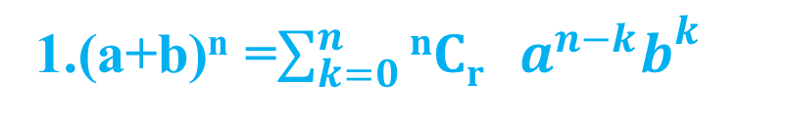
Observations:
2.The coefficient ^{n}C_{r} occurring in the binomial
theorem are known as binomial coefficients.
3.There are (n+1) terms in the expansion of (a+b)^{n}
4.In the successive terms of the expansion the index of
a goes on decreasing by unity. At the same time the
index of b increases by unity.

Slide 22
5.
In the expansion of (a+b)^{n} ,the sum of indices of a and b is n+0=n in the first term,(n-1)+1=n in the second term and so on 0+n=n in the last term.
Thus it can be seen that the sum of the indices of a and b is n in every term of the expansion.

Slide 23
Example 4:
Compute (98)⁵ , using Binomial theorem.
= ⁵C₀(100)⁵ --⁵C₁(100)⁴.2 + ⁵C₂(100)³.2²--⁵C₃(100)².2³+⁵C₄(100).2⁴+⁵C₅(100)⁰.2⁵
= 10000000000 -5.100000000.2+
10.1000000.4 - 10.10000.8 +5.100.16 - 32
=10040008000 - 1000800032
=9039207968

Slide 24
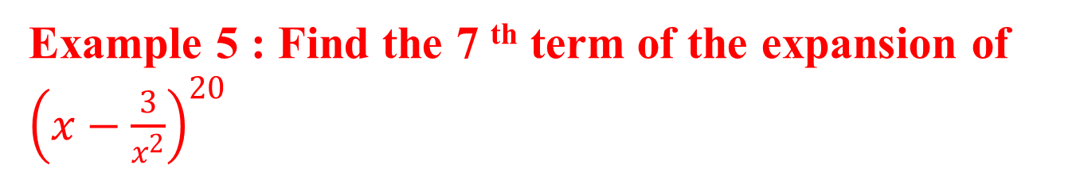
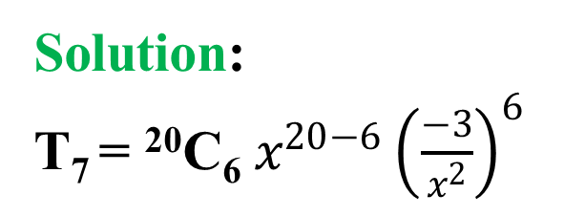
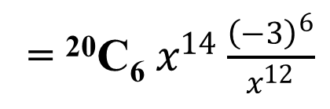
General trem of Binomial expansion
(r+1) th term of Binomial expansion
= T_{r+1}= ^{n}C_{r}a^{n-r}b^{r}
= ²⁰C₆ 3⁶x²

Slide 25
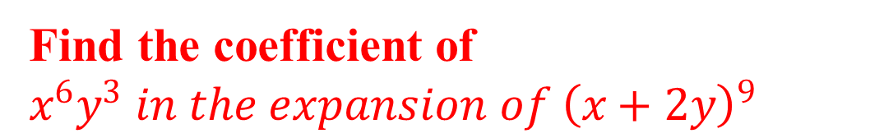
Example 6:
Solution:
T_{r+1}= ⁹C_{r}x^{9-r}(2y)^{r}
= ⁹C_{r} .2^{r}.x^{9-r}.y^{r}

Slide 26
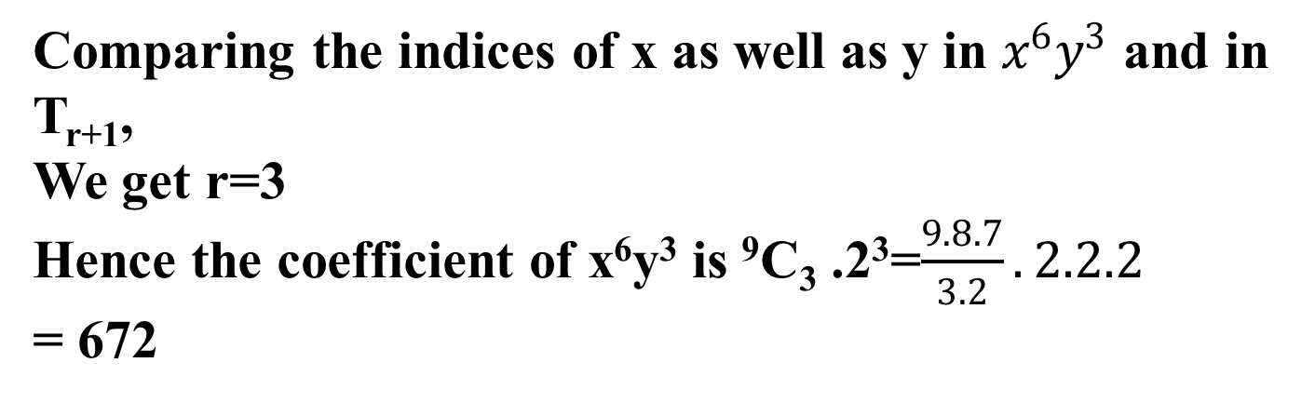

Slide 28
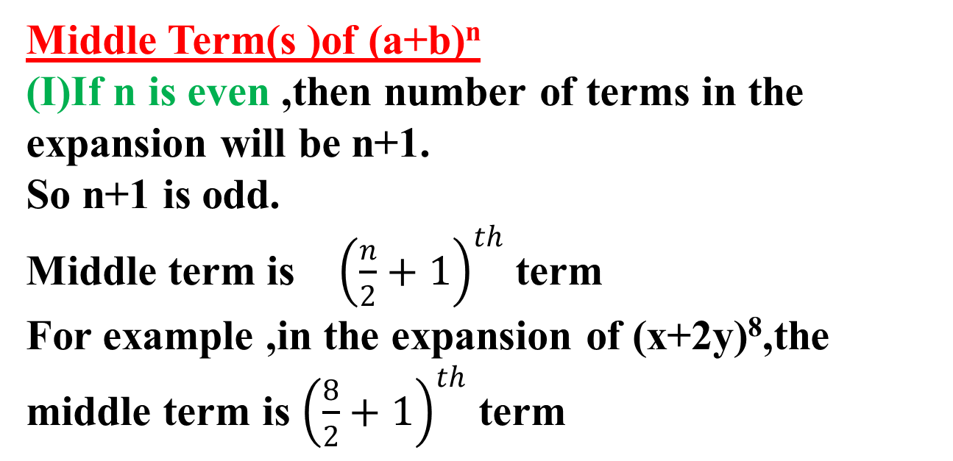

Slide 29
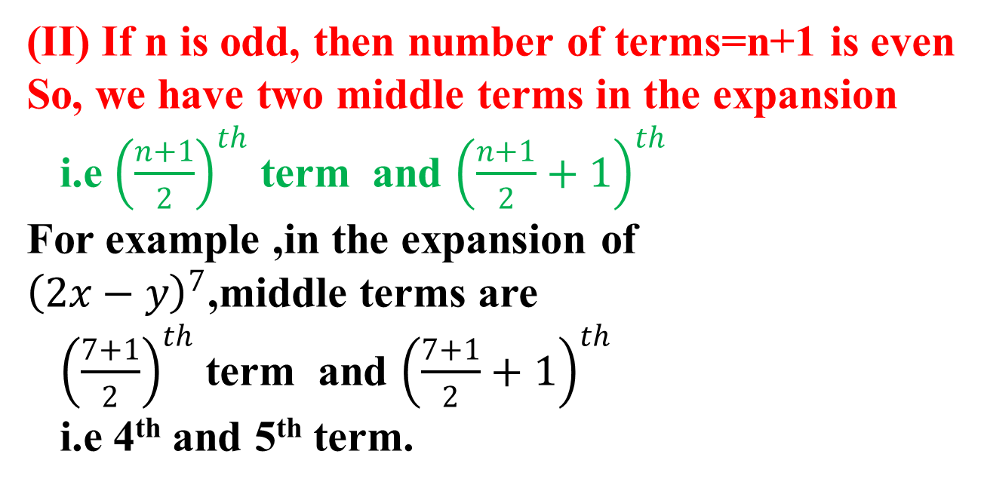

Slide 30
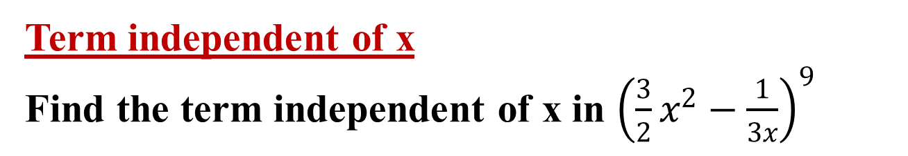
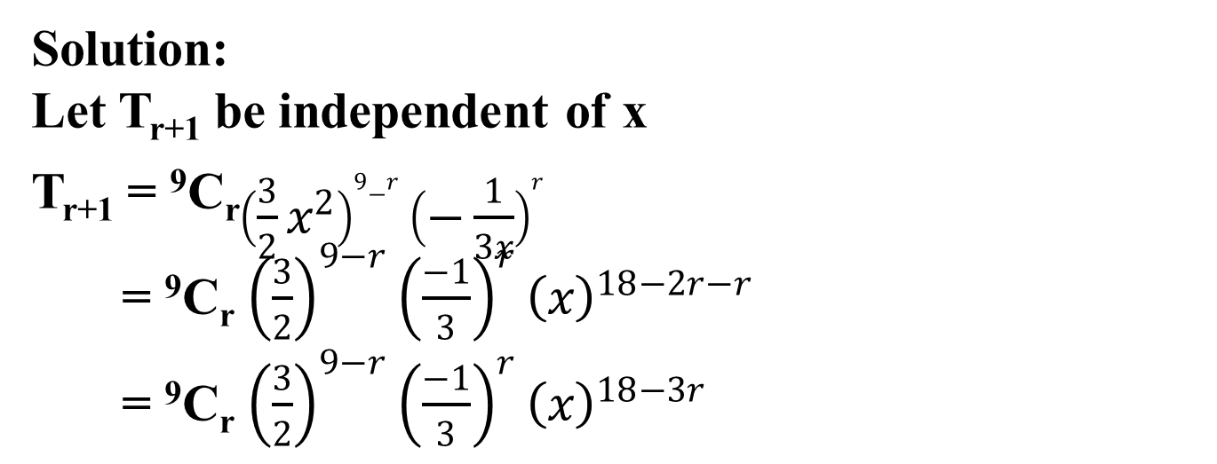

Slide 31
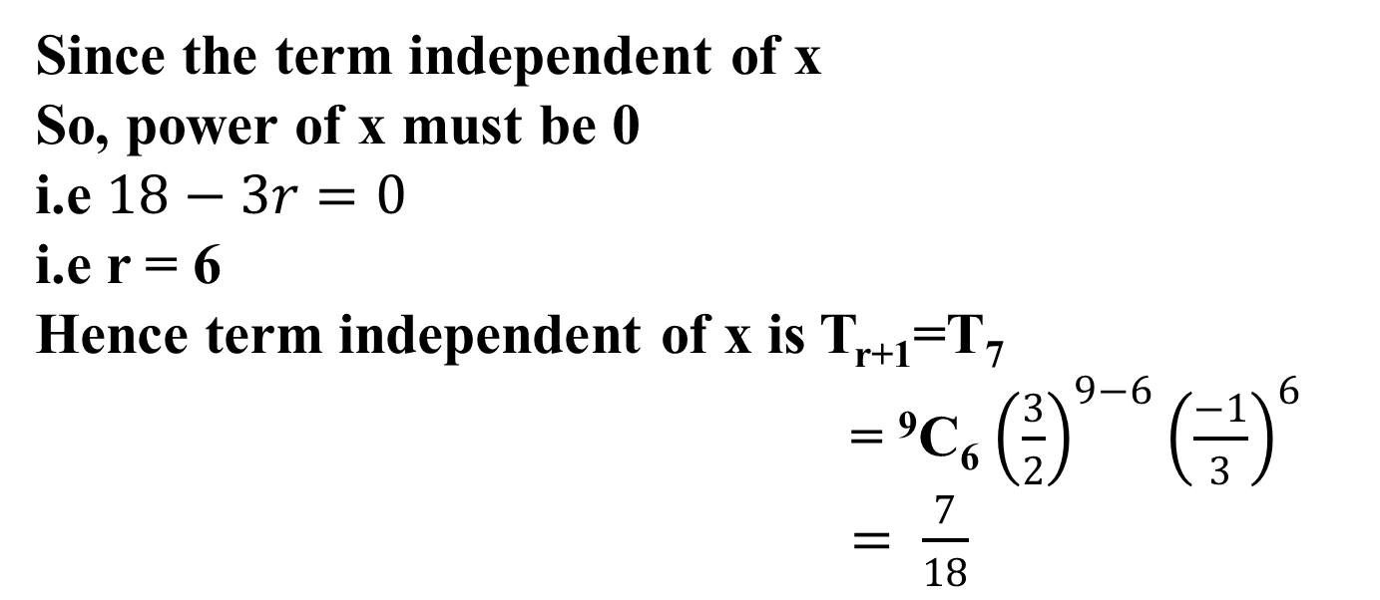

Slide 32
Example 7:
Find the r^{th} term from the end in the expansion of (x+a)^{n}
Solution:
There are (n+1) terms in the expansion of (x+a)^{n}
i.e T₁, T₂, T₃, T₄, …….., T_{n-1}, T_{n}, T_{n+1}
So, first term from end is the (n+1)^{th} term from beginning and n+1= (n+1)-(1-1)

Slide 33
Second term from end is
(n+1)-(2-1)=n^{th} term from beginning
Third term from end is the
(n+1)-(3-1) = (n-1)^{th} term from beginning and so on
Similarly, r^{th} term from end is (n+1)-(r-1)=(n-r+2)^{th} term from beginning.
Hence required r^{th} term from end
= T_{n-r+2}= ^{n}C_{n-r+1}x^{r-1}a^{n-r+1}.

Slide 34

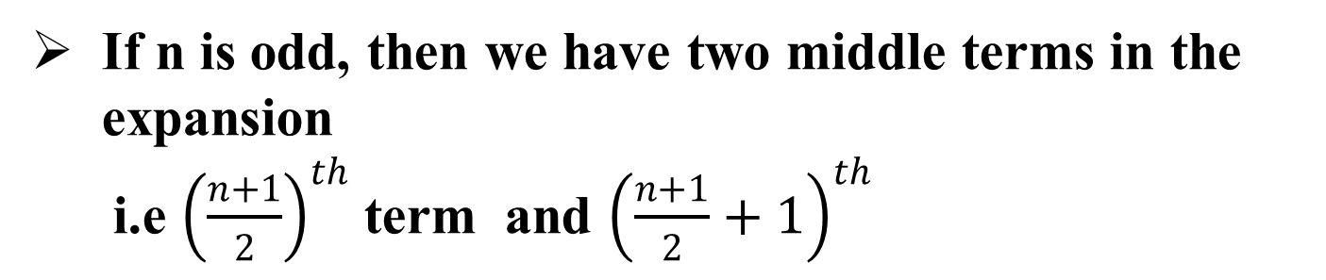
SUMMARY
(a + b )^{n} = ^{n}C₀a^{n} + ^{n}C₁a^{n-1}b + ^{n}C₂a^{n-2}b² +……+ ^{n}C_{n-1}ab^{n-1}+ ^{n}C_{n} b^{n}
General term T_{r+1}= ^{n}C_{r}a^{n-r}b^{r}

Slide 35
r^{th} term from the end in the expansion of (a+b)^{n}
=(n-r+2)^{th} term from beginning.

Slide 36
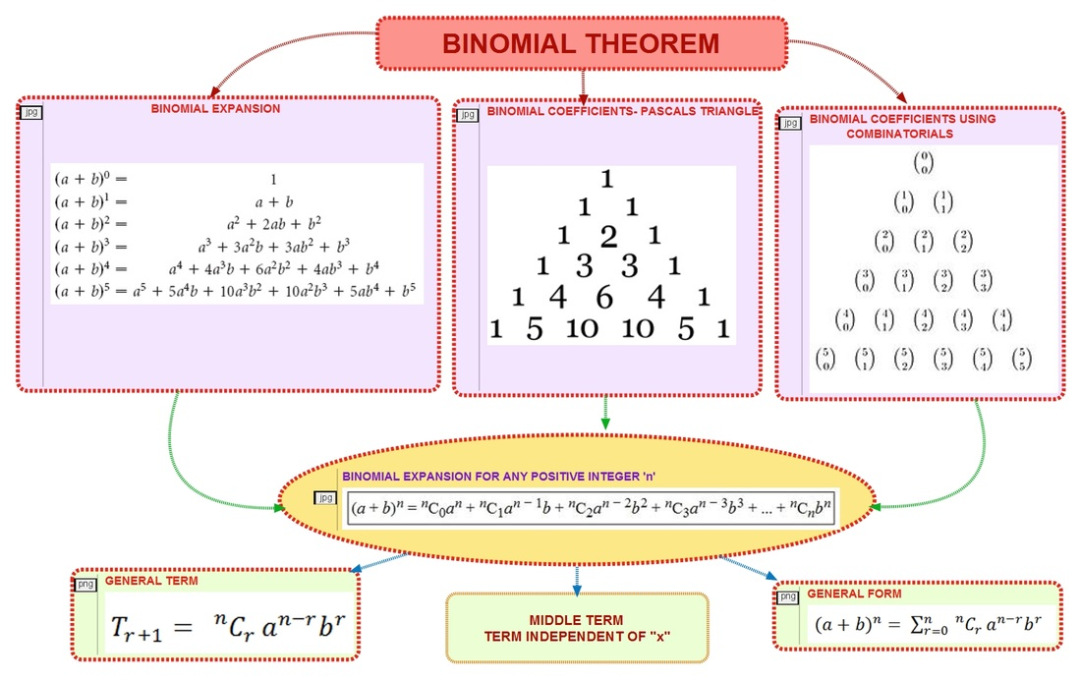
CONCEPT MAP

Slide 37
THANK YOU

